Slide 1
SMART PUBLIC RESTROOM MANGEMENT
Phase-3:DEVELOPMENT PART 1

Slide 2
INTRODUCTION
In this part you will begin building Your project.
Start building the IoT-enabled Smart Public restroom mangement
Phase-3-Development part 1

Slide 3
PROJECT REQUIREMENTS
Microcontroller
Power supply
LCD display
Buzzer
Infrared sensor
Sonicsensor
Gassensor
RFID
GSMmodem
Embedded C

Slide 4
WORKING PRINCIPLE
In the first phase, IR sensor is used to discover the dirt present in the toilet. Here the set of sample images are given as input. After using the toilet, the sensor senses the basin of the toilet. Then it relates the sensed image with the input image. If the dirt present, it increases the alarm. Then the user wants to be clean the waste. Through this activity, people can get the awareness about the toilet management. In the second phase, Figaro sensor is used to perceive the unwanted gases present in the toilet.

Slide 5
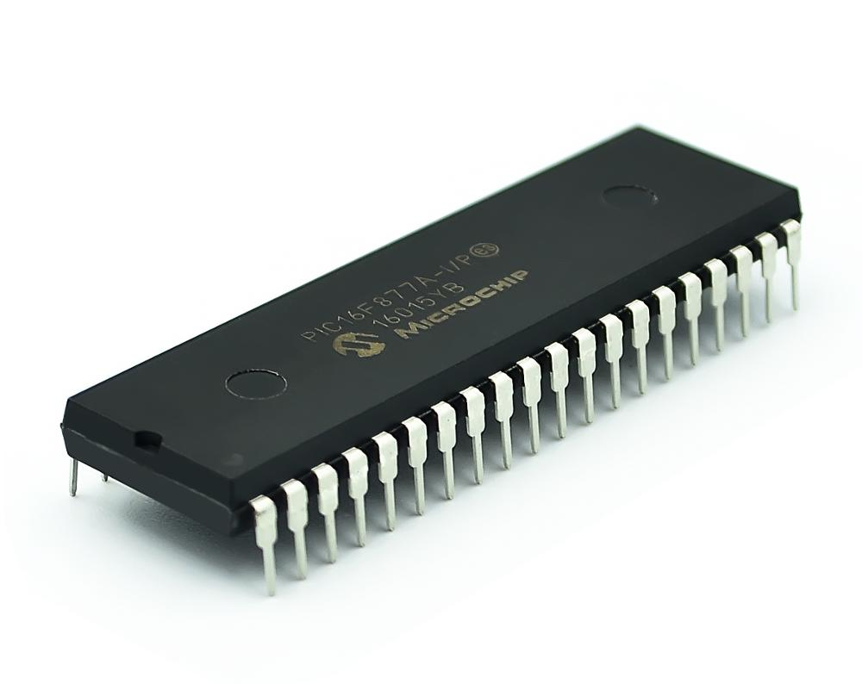
Microcontroller
PIC 16F877 is one of the most advanced microcontroller from Microchip. This controller is commonly used for experimental and modern applications because of its low price, wide range of requests, high quality, and ease of obtainability. It is ideal for applications such as machine control applications, measurement devices, study purpose, and so on. The PIC 16F877 features all the mechanisms which present microcontrollers usually have.

Slide 6
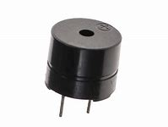
BUZZER
Buzzer is also called as Beeper. It is a sound signalling mechanical devices

Slide 7
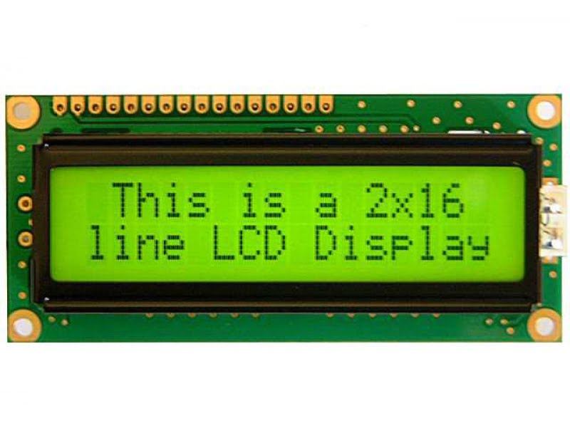
LCD Display
LCD stands for Liquid Crystal Display. By using the LCD, all the outputs are displayed. LCD doesn’t know about the content (data or commands) supplied to its data bus. It is the user who has to specify whether the content at its data pins are data or commands

Slide 8
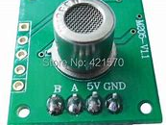
Smell Sensor
The Smell Sensor is used to detect the unwanted smell and gases in the toilet. For this purpose, we are going to use the sensor called Figaro sensor. Smell Sensor It cansintellect the dry gases present in the toilets such as NH3, CO2, CH4, H2S, etc. By taking those gases leads to Nausea, Drowsiness, instant loss of awareness, etc. After sensing the unwanted gases, it can blink the red light. Then the sweeper can clean it by using particular Cleaning Agen

Slide 9
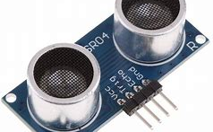
Sonic sensor
The Sonic Sensor is used for computing the depth. Here it is used to measure the depth of the septic tank. The Sonic Sensor is fixed into the Septic tank. Then the Septic tank get filled means, it can sends the communications to particular organization. Then they will allot persons to clean the septic tank. Then septic tank cleaners will clean the tank. After cleaning it, the sensor can detect the level, and send messages to consistent organization.

Slide 10
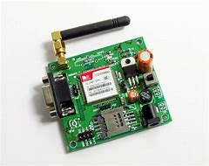
GSM module
SM stands for Global System for Mobile communication. It establishes the mobile communication from one place to another place .It transfers the information from main circuit to operator. It uses Time Division Multiple Access (TDMA).

Slide 11
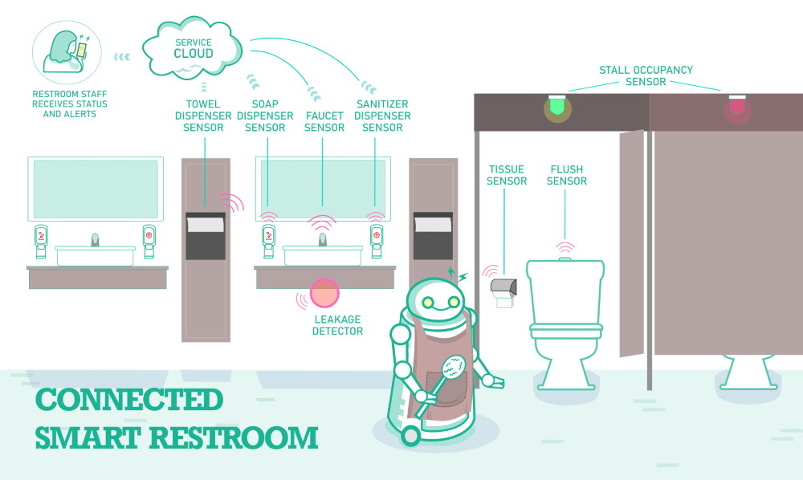
Working model
This is the module of the proposed system. Here the sensors are connectAed with the microcontroller

Slide 12
THANK YOU

